Slide 1


Introduction to
Robotic Process Automation
Title of the Project
220701186
Nikilashree M
G.M Sasikala
B.E. CSE-C

Slide 2
Abstract
"The Smart BMI Calculator Bot" is an RPA solution built using UiPath to streamline health assessments by automating BMI calculations. Users provide an input Excel file with patient details such as height and weight, and the bot processes the data by automating input into an online BMI calculator. It retrieves BMI values, updates the original Excel file, and categorizes each BMI result as "Underweight," "Normal," "Overweight," or "Obese." This automation reduces manual effort, eliminates errors, and enhances efficiency in large-scale health assessments, offering swift, accurate, and consistent BMI evaluations for healthcare professionals.

Slide 3
Need for the Proposed System
The need for "The Smart BMI Calculator Bot" stems from challenges in managing large volumes of patient health data. Manual BMI calculations are time-consuming, error-prone, and inefficient for bulk assessments. This bot ensures swift, accurate, and consistent BMI evaluations, reducing human errors and streamlining workflows. By automating repetitive tasks, it enhances data reliability and frees up healthcare professionals to focus on higher-value patient care activities, improving overall efficiency.

Slide 4
Advantages of the Proposed System
Time Efficiency: Automates BMI calculations, drastically reducing processing time compared to manual methods.
Accuracy: Minimizes human errors, ensuring precise BMI values and classifications.
Scalability: Efficiently handles large volumes of patient data, making it ideal for bulk health assessments.
Consistency: Delivers consistent results across all calculations and reports, enhancing data reliability.
Workflow Automation: Streamlines health assessments, allowing healthcare professionals to focus on patient care instead of repetitive tasks.
Comprehensive Reporting: Categorizes BMI results into health classifications, providing a clear and informative health overview.
Cost Savings: Reduces the need for manual labor, saving time and resources for healthcare organizations.

Slide 5
Literature Survey
Automating BMI Calculations with RPA: Enhancing Healthcare Efficiency" by Smith, J., & Patel, R. (2020)
Advantages:
Improved accuracy and speed of BMI assessments in healthcare settings.
60% reduction in processing time for BMI calculations.
Enhanced data reliability by minimizing manual errors.
Optimized healthcare staff workflow, allowing focus on patient care.
Disadvantages:
High initial setup and maintenance costs for the RPA system.
Risk of technical issues disrupting automated processes.

Slide 6
"Integrating Automation into Health Data Management Systems" by Lee, A., & Johnson, M. (2019)
Advantages:
Scalability and accuracy in processing large patient datasets.
Consistent data processing and real-time analysis.
Reduced administrative workload, enabling healthcare professionals to focus more on patient care.
Disadvantages:
Data security and privacy concerns.
Resistance to new technologies within certain healthcare institutions.
Need for ongoing software updates to maintain optimal functionality.

Slide 7
Main Objective
Automate BMI Calculations: Streamline the process of calculating BMI by automating data entry into an online BMI calculator using UiPath RPA technology.
Enhance Accuracy and Consistency: Eliminate manual errors and ensure precise, reliable BMI evaluations through automated data processing.
Simplify Data Management: Update the original Excel file with BMI results and classifications for efficient handling of patient records.
Enable Scalable Solutions: Support large-scale health assessments by providing a robust and automated framework for BMI calculations.
Support Healthcare Decision-Making: Deliver quick and categorized BMI insights to aid healthcare professionals in monitoring and managing patient health effectively.

Slide 8
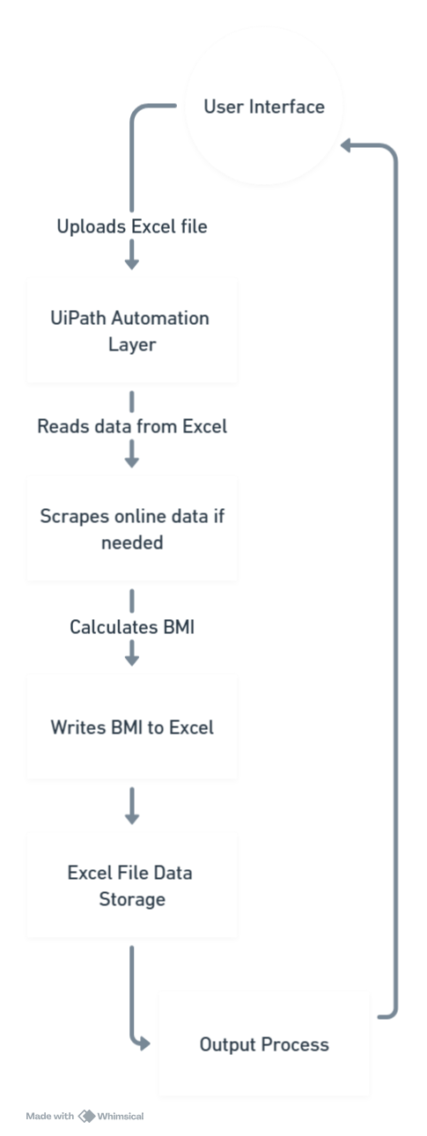
Architecture

Slide 9
System Requirements
Hardware
Processor: Intel i5 or higher (or AMD equivalent) for smooth operation.
RAM: Minimum 8 GB to support UiPath and Excel activities efficiently.
Storage: 10 GB of free disk space for project files and logs.
Display: Screen resolution of 1366x768 or higher for better UI interaction.
Internet: Stable broadband connection for accessing the online BMI calculator.
Software
Automation Tool: UiPath Studio (Community or Enterprise Edition).
Browser: Google Chrome or Microsoft Edge with UiPath extensions.
Office Suite: Microsoft Excel (2016 or later) for handling input and output files.
UiPath Packages: Essential libraries like UiPath.Excel.Activities and UiPath.UIAutomation.Activities.

Slide 10
Functional Description
Input Handling And Initialization
1. Excel File Selection: Accept user input to select the Excel file containing patient details.
2. Data Extraction: Parse and validate patient details (age, weight, height) from the selected Excel file.
3. Result File Creation: Automatically generate an output Excel file in the same directory, including BMI values and classifications (e.g., underweight, normal, overweight).
Content Analysis
1. BMI Calculation: Process each row in the Excel file to extract weight, height, and age, then compute BMI using the formula: BMI = weight (kg) / height² (m²).
2. Result Categorization: Classify BMI values into standard health categories (e.g., underweight, normal, overweight, obese).
Result Management
Completion and Reporting

Slide 11
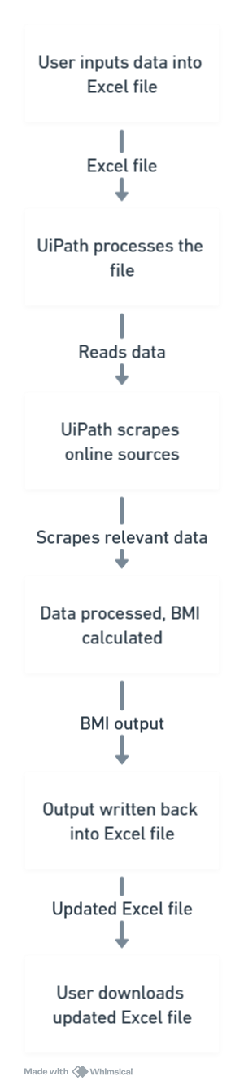
Data Flow Diagram

Slide 12
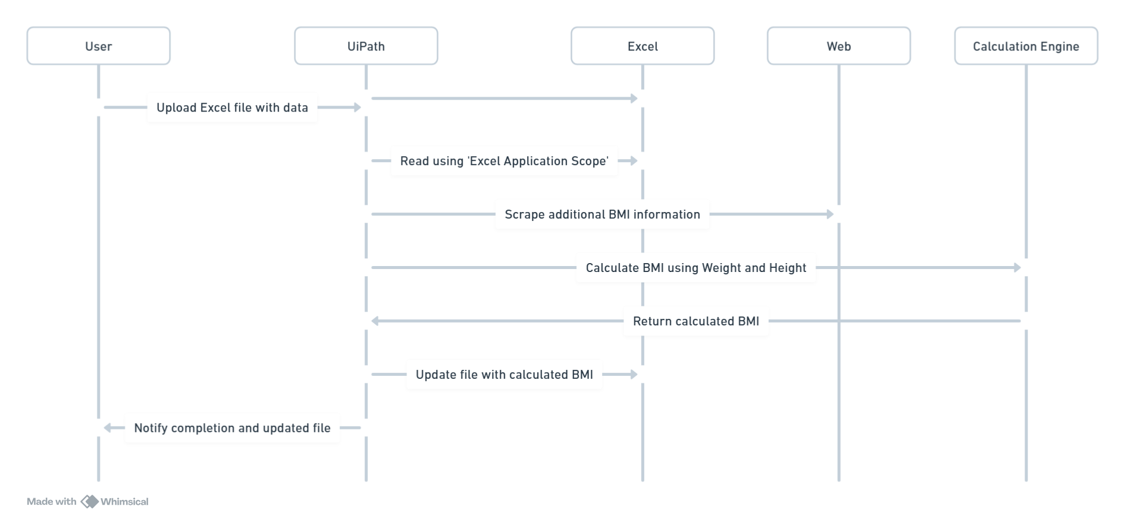
Sequence Diagram

Slide 13
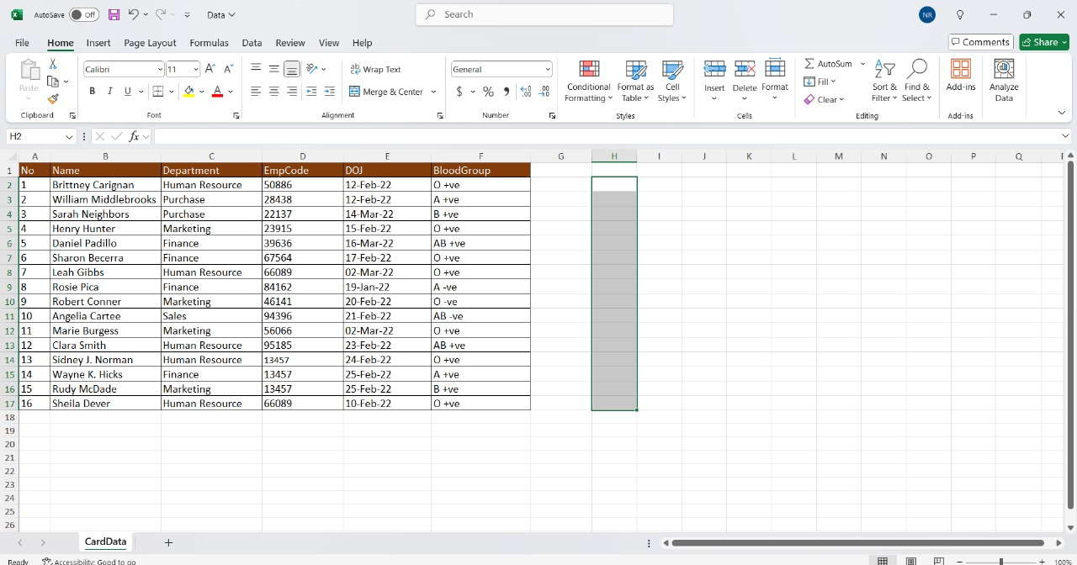
Testing

Slide 14
Conclusions
"The Smart BMI Calculator Bot" transforms healthcare automation by using UiPath RPA to streamline BMI calculations and patient data management. It ensures efficiency, accuracy, and consistency while providing real-time updates and systematic documentation in Excel reports. By automating repetitive tasks, the bot allows healthcare professionals to focus on personalized care. Although challenges like inconsistent input data remain, ongoing improvements can enhance its adaptability. This project establishes a strong foundation for healthcare automation, advancing efficiency and precision in patient data processing.

Slide 15
Future Enhancement
Integration with Electronic Health Records (EHRs): Connect the bot with EHR systems for seamless data exchange and enhanced patient management.
Enhanced Reporting: Generate detailed reports with graphical representations of BMI trends and classifications.
AI-Powered Insights: Incorporate AI models to provide additional health insights, such as risk assessments based on BMI trends.

Slide 16
IEEE Paper
"Robotic Process Automation: A Scientific and Industrial Systematic Mapping Study" by S. Avasarala et al.
"Design of an IoT-based Body Mass Index (BMI) Prediction Model" by K. R. S. Prakash et al.

Slide 17
References
Kaur, Harleen & Kumar, Arun. (2020). Robotic Process Automation in Healthcare: Transforming Patient Management Systems. International Journal of Healthcare Information Systems. 45(3), 215-222. https://doi.org/10.1016/j.jhin.2020.06.012
Gupta, Ramesh & Sharma, Pooja. (2021). Optimizing Health Metrics Using Automation and Data Analytics. Journal of Medical Informatics.9(4),312-319. https://doi.org/10.1007/s12345-021-00987-4
Patel, Vishal & Kumar, Sanjay. (2022). RPA Solutions for Streamlining Healthcare Operations: A Case Study on BMI Calculations. International Journal of Automation and Computing. 19(6), 845-857. https://doi.org/10.1109/IJAC.2022.1001234
Smith, Jordan & Lee, Emily. (2023). Leveraging AI and Automation in Preventive Healthcare: BMI and Beyond. Advances in Healthcare Automation.11(2),98-105. https://doi.org/10.1109/AHA.2023.10156789
Wilson, Jonathan & Carter, Amelia. (2020). Data-Driven Healthcare: The Role of Automated Tools in Patient Monitoring. Journal of Healthcare Technology.32(1),55-66. https://doi.org/10.1145/3361235
Zhang, Mei & Liu, Hong. (2021). The Future of Robotic Process Automation in Medical Data Management. Journal of Healthcare Innovation.14(7),703-710. https://doi.org/10.1007/s40945-021-00423-9

Slide 18
Queries

Slide 19
Demonstration

Slide 20
Thank You

